Slide 1
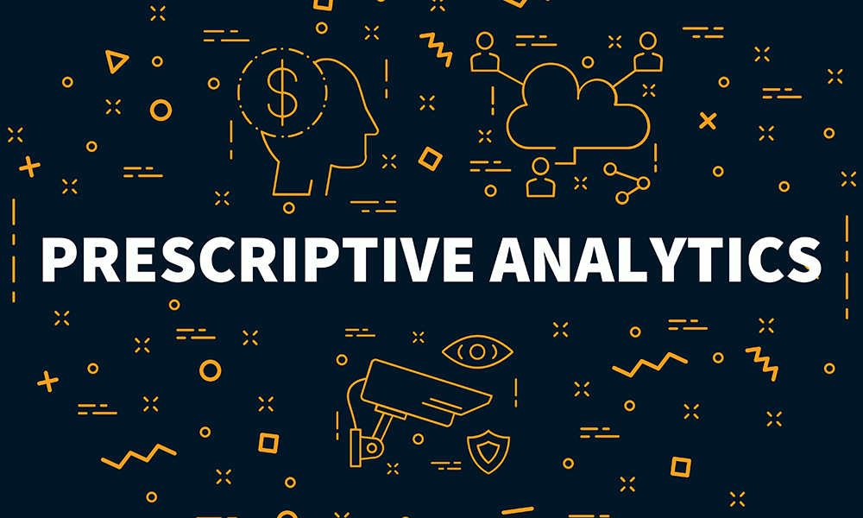
Prescriptive Analytics
By- Priyanshu Goswami
Data Science Intern, HackVeda
Date: 21/11/2024

Slide 2
OVERVIEW:-
Introduction
Conversation
Prescriptive Analytics
Method & Techniques
Hook
Story
Demonstration
Conclusion

Slide 3
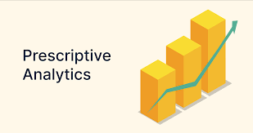
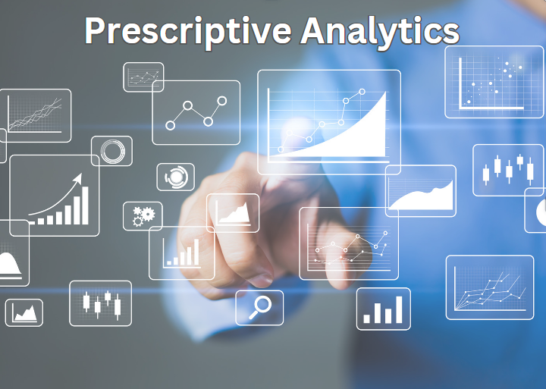
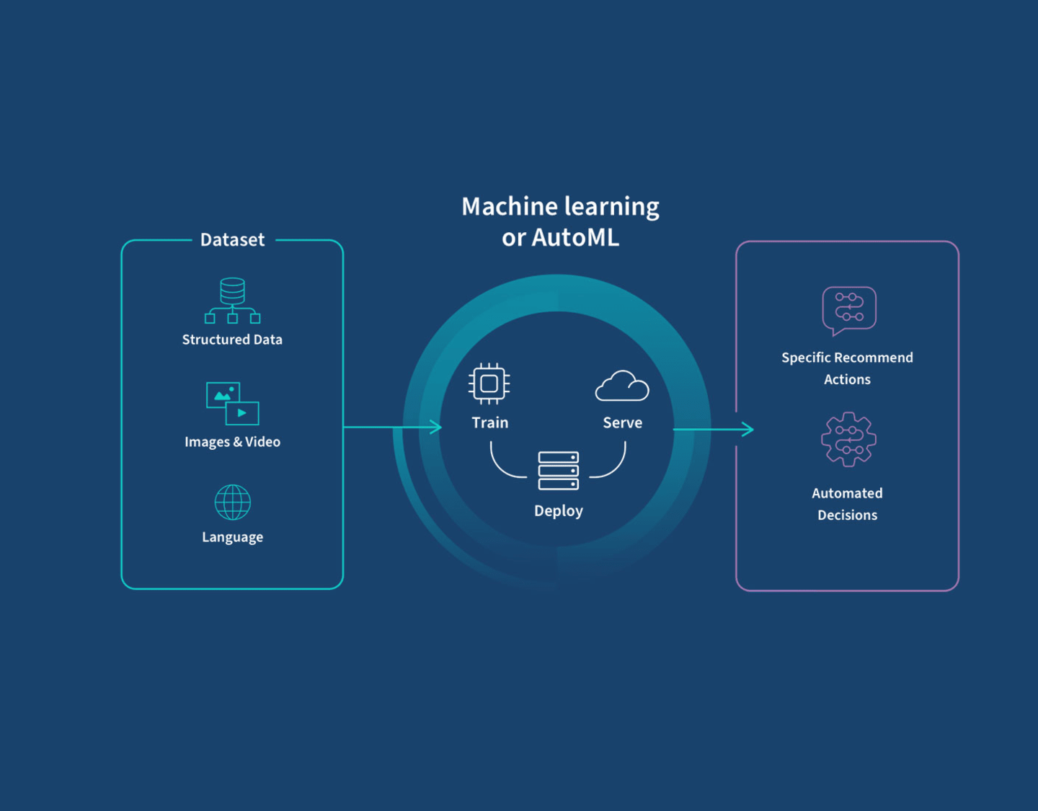
Introduction:-
Prescriptive Analytics is a type of data analytics that provides actionable recommendations for decision-making. It goes beyond understanding past data or predicting future trends by suggesting the best actions to achieve desired outcomes. Using techniques like optimization algorithms, simulations, and machine learning, it helps businesses optimize decisions in areas like supply chain, marketing, and finance. The goal is to improve decision-making, reduce costs, and gain a competitive advantage by recommending the most effective actions based on data insights.

Slide 4


Prescriptive Analytics hook:
"Imagine having the power to not only predict the future but also to shape it—prescriptive analytics turns data into action, providing you with the best strategies to make smarter, faster decisions and drive success."

Slide 5

Story: Optimizing Delivery Routes with Prescriptive Analytics:-
At a logistics company, FastTrack Delivery, business was booming, but so were the challenges. They had hundreds of trucks delivering packages across the city every day. Although they had a general idea of the most efficient routes, traffic jams, weather conditions, and sudden delays often caused delays, leading to late deliveries and frustrated customers.
One day, the company decided to implement prescriptive analytics to improve their operations. They integrated real-time traffic data, weather forecasts, and customer demand patterns into their system. The system then used optimization algorithms to analyze all this data and suggest the most efficient routes for each delivery truck.
For example, one of the trucks was scheduled to make deliveries during rush hour. The prescriptive analytics tool suggested an alternative route that avoided a traffic-prone area and recommended shifting some deliveries to a later time when traffic would be lighter.
The results were impressive. With prescriptive analytics, FastTrack not only reduced fuel consumption by finding shorter routes but also improved delivery times by adjusting schedules based on traffic conditions and customer priorities. Late deliveries decreased by 30%, and customer satisfaction increased as they received their packages on time.
The company’s ability to make smarter, real-time decisions based on prescriptive insights gave them a competitive edge, reduced operational costs, and strengthened their reputation as a reliable delivery service. This is a clear example of how prescriptive analytics can be used to optimize day-to-day business operations and drive success.

Slide 6

Hey, I’ve been assigned a task on prescriptive analytics. The project involves optimizing inventory management using the Product Demand Forecasting dataset from Kaggle. My goal is to use optimization algorithms like linear programming, integer programming, and mixed-integer programming to find the best solution.
Sounds interesting! What exactly are you aiming to optimize in the inventory management process?
RIYA
TIYA

Slide 7
I’ll be focusing on optimizing the inventory levels for a product. The objective is to minimize costs while meeting customer demand. I’ll also be using sensitivity analysis to see how changes in demand, lead time, and holding cost affect the optimal solution.
Great! You’ll probably need to define your constraints clearly for each optimization technique, especially around inventory levels, ordering frequency, and storage costs. Also, once you’ve solved the problem, you should evaluate the solution with metrics like cost, revenue, and profit.
RIYA
TIYA

Slide 8
Yes, I think that’s the right approach. I’ll use linear programming for the basic optimization model and then look into mixed-integer programming if there are constraints that require more detailed decisions, like fractional versus whole units of products.
Exactly! Make sure to check for any possible trade-offs between cost reduction and customer service levels. Your sensitivity analysis will help you understand how flexible your solution is under varying conditions. How will you present your findings?
RIYA
TIYA

Slide 9
Sounds like a solid plan. Make sure to test with real-world scenarios too, so that the results are actionable. Let me know if you need any help with the modeling or analysis.
I’ll prepare a Jupyter Notebook with all the steps, from data preprocessing to applying the optimization models. Then, I’ll also create a report that explains the methodologies used, the results, and the impact of different parameters on the solution.
RIYA
TIYA

Slide 10
Thanks! I’ll get started and reach out if I run into any issues. The deadline is next week, so I’ll keep you updated on my progress.
Good luck!
RIYA
TIYA

Slide 11
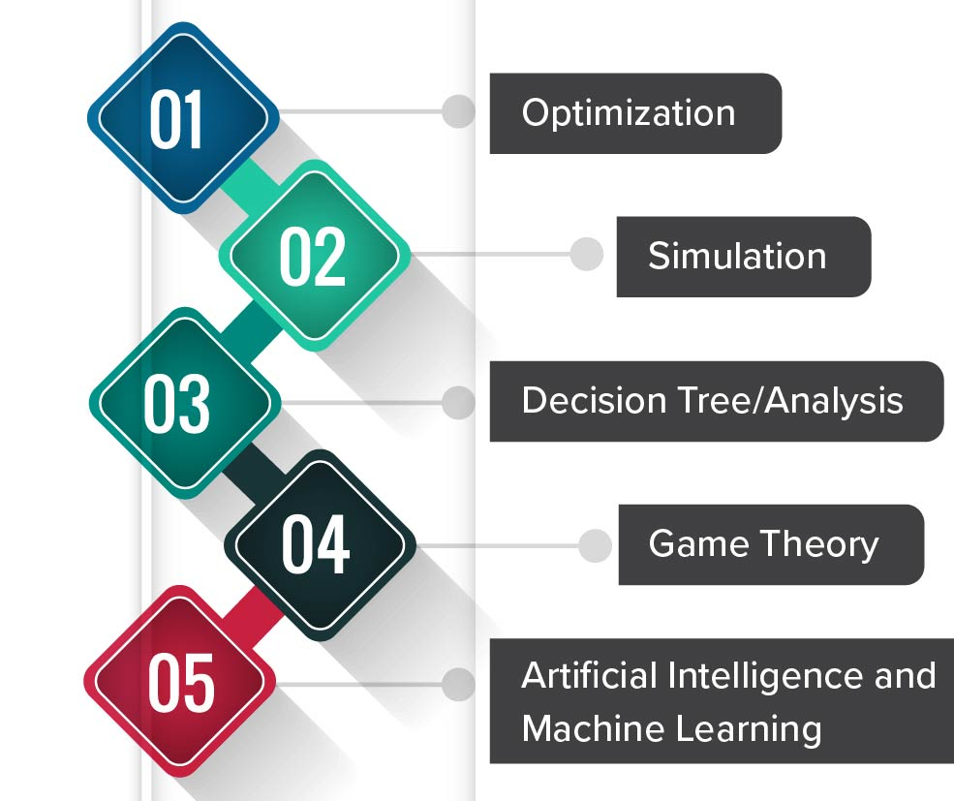
Techniques & Methods:-
Process done in following Methods :-
1. Optimization
2. Simulation
3. Decision Tree/ Analysis
4. Game Theory
5. Artificial Intelligence and Machine Learning

Slide 12
DEMONSTARTION

Slide 13

Through prescriptive analytics, we optimized the inventory management process by calculating optimal order quantities and reorder points, ensuring cost-effective and demand-sufficient inventory levels. The sensitivity analysis revealed the impact of variations in demand, lead time, and holding costs, guiding inventory strategies for fluctuating market conditions.
Conclusion

Slide 14
Reference & Components
For Data-set:-
Download the "Product Demand Forecasting" dataset from Kaggle: https://www.kaggle.com/felixzhao/productdemandforecasting
For Python and Jupyter Notebook:-
https://www.anaconda.com/download
For Presentation:-
https://www.youtube.com/watch?v=LYcOs6kdeTY&t=1602s

Slide 15
Thank You
Q & A

